Slide 1
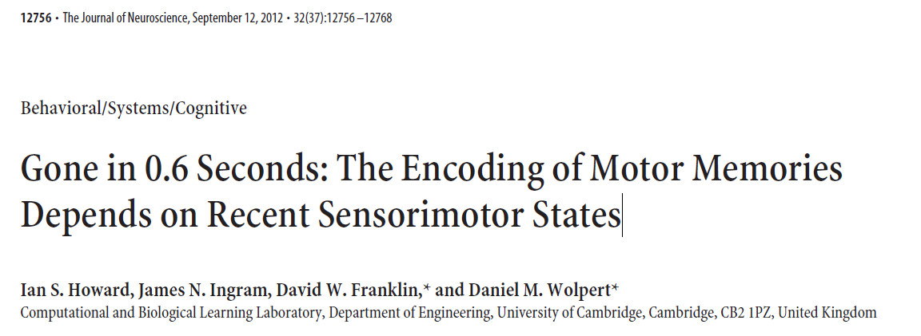
James Mathew
04-10-2019

Slide 2
Objective
AIM : To investigate whether motor memories encode the current action in a manner that depends on previous sensorimotor states.
HOW: Human subjects performed trials in which they made movements in a randomly selected clockwise or counterclockwise velocity-dependent curl force field. Movements during this adaptation phase were preceded by a contextual phase that determined which of the two fields would be experienced on any given trial.

Slide 3
Introduction
Contextual Cues:
When two opposing visuomotor or dynamic (force-field) perturbations are presented sequentially, there is substantial interference
However, if contextual cues are associated with each perturbation, interference can be reduced
By the “contextual cues” of a movement we refer to states of the world and body excluding those directly associated with the arm while it experiences the perturbation.
Therefore, context can be visual cues, movement of other body parts, or states of the arm before the perturbed movement.
Such cues are typically presented concurrently with movement, allowing the formation and recall of separate motor memories.
500ms window:
Evidence from classical conditioning in the cerebellum suggests that cue effectiveness decays with time: cues provided within 500 ms are most effective.
Similarly, the relationship between Purkinje cell activity and arm kinematics shows a correlation that decays over a 500 ms period into the past.
Because the cerebellum is also known to play an important role in adaptation to dynamic force fields, we hypothesized that a temporal window of 500 ms may exist during which previous motion can provide a cue for learning opposing perturbations.

Slide 4
Methods
Each trial consisted of a contextual phase followed by an adaptation phase.
During the adaptation phase, subjects made a movement in one of two opposing curl fields, with field direction in each trial predictable from the contextual phase.

Slide 5
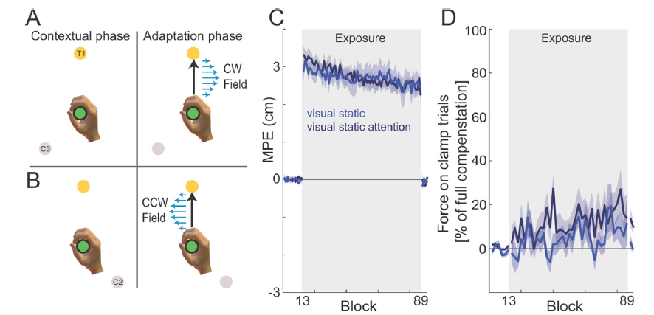
Experiment 1: static visual contexts (n 16)
On each trial, a visual cue, the center location, and the final target were displayed and the vBOT applied a force to guide the subject’s hand to the center location
The start of the trial was cued by an acoustic tone. At a fixed time interval after the tone (510 ms), subject should initiate a movement to the target (within 50–400 ms of the color change)
Error-clamp trials constrain the movement onto a straight line from the start to the target position.

Slide 6
Experiment 2: temporal decay of contextual motion effect (n16)
Experiment 2 was designed to examine the contextual effects of previous movement.
On each trial, the contextual phase consisted of a 10 cm movement (in a null field) to the central location
Center location can be considered as a via point from the starting location to the final target.
Dwell time: One group was required to make a continuous movement (0 ms dwell time), whereas the other groups were required to have a dwell time within one of three ranges: 150–300, 500–1000, or 1000–1500 ms (we refer to these as 150, 500 and 1000 ms dwell time groups).

Slide 9
Experiment 3: contextual motion before target location (n 8)
In all the previous experiments, subjects could plan the motor command required for the adaption phase from the start of the contextual phase.
In experiment 3, whether the sensorimotor system was still able to use information from the contextual phase without initially knowing what the adaptation phase would be.
The final target was only displayed when subjects reached the central location

Slide 10
Experiment 4: sensorimotor cues that may mediate contextual effects
To examine the sensorimotor cues that may mediate contextual effects, experiments were performed examining
visual cursor motion without arm movement,
visual cursor motion without arm or eye movement,
active arm movement without visual motion,
passive arm movement without visual motion, and
isometric force generation without visual motion.

Slide 12
RESULTS:
When static visual cues were presented in the contextual phase, strong interference (resulting in an inability to learn either field) was observed.
In contrast, when the contextual phase involved subjects making a movement that was continuous with the adaptation-phase movement, a substantial reduction in interference was seen.
As the time between the contextual and adaptation movement increased, so did the interference, reaching a level similar to that seen for static visual cues for delays 600 ms.
This contextual effect generalized to purely visual motion, active movement without vision, passive movement, and isometric force generation.
IMPLICATION:
Results show that sensorimotor states that differ in their recent temporal history can engage distinct representations in motor memory, but this effect decays progressively over time and is abolished by 600 ms.
This suggests that motor memories are encoded not simply as a mapping from current state to motor command but are encoded in terms of the recent history of sensorimotor states.

Slide 13
Mathematical modelling
Previous computational studies of dynamic learning suggest that subjects learn a mapping from current state to the force required to compensate for the field (Thoroughman and Shadmehr, 2000;Donchin et al., 2003; Franklin et al., 2008).
That is, the force vector (Ft) at time t is some function of position (xt) and velocity (vt), Ft g(xt, vt).
Our results suggest that the representation may not simply depend on the current state but also on previous states.
For example, we can write that force at time t depends on previous states s (including visual and proprioceptive inputs as well as motor output) over a 600 ms window as follows Ftg(st, st1, st2, . . . st600), representing time discretely in 1 ms steps.
As dwell time decreases, more elements of {st, st 1, st 2, . . . st 600} are different for the two fields, and hence more terms contribute to disambiguate them.
Our results suggest that st may represent active and passive arm motion, visual motion, or isometric force generation.
The mathematical properties of the derived primitives (force,pos, vel,etc) resemble the tuning curves of Purkinje cells in the cerebellum ; many Purkinje cells simultaneously encode the direction and speed components of velocity

Slide 14
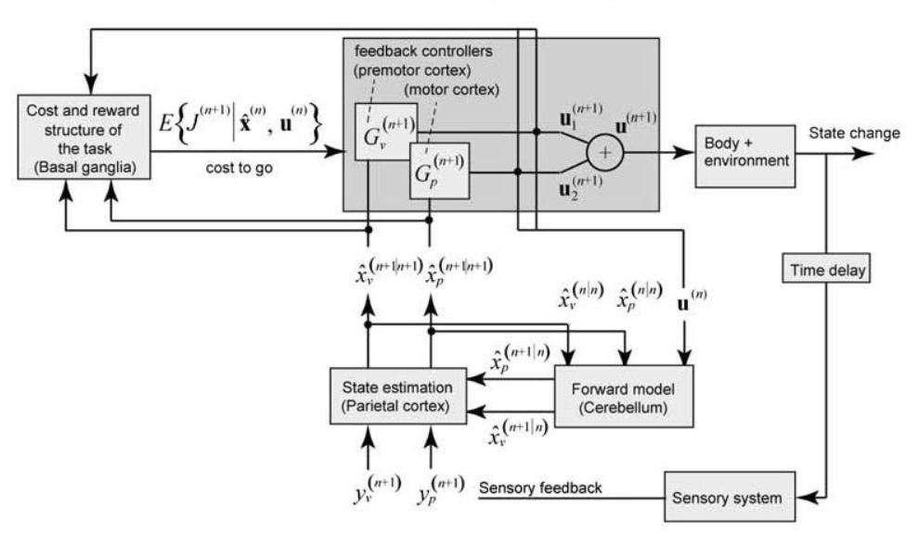
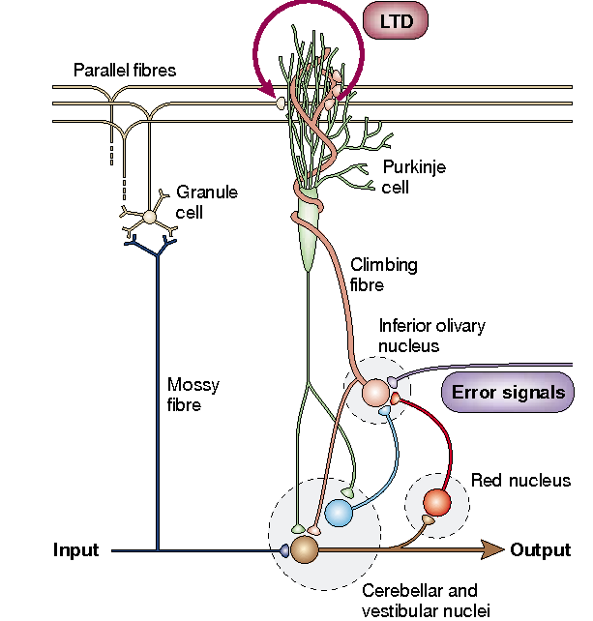
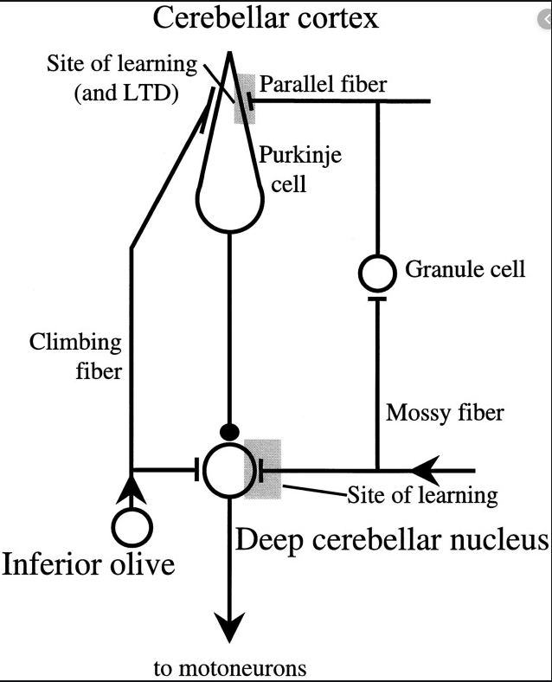
Neural Correlates
Shademehr & Krakeur 2008
Marr-Albus-Ito model, Ito 2002
Lisberger 1998
Contextual cues are presented to Purkinje cells via the parallel fiber system (Kimand Thompson, 1997).
Purkinje cells learn which contextual cues (which parallel fiber inputs) can predict (and correct) the erroneous motor output.
Purkinje cells can encode the kinematics of active movements (Harvey et al., 1977), passive movements (Rubia and Kolb, 1978), and target motion during a tracking task (Shidara et al., 1993).
More recently, Purkinje cell activity was found to correlate with arm kinematics over a window extending 500 ms into the past (Hewitt et al., 2011).
Moreover, the cerebellum plays an important role in dynamic force-field learning (Maschke et al., 2004; Smith and Shadmehr, 2005) and may implement internal models in the motor system (Miall et al., 2007; Ebner and Pasalar, 2008; Hewitt et al., 2011)

Slide 15
Merci

